Slide 1


Fundamentals of RM
RM System and Process
Leadership in RM
Incident Investigation
RM Tools & Challenges
RM in Industry
People & Org.
Application and Perspectives
On Becoming a
Leader in Risk Management
ENGG404 - Lecture
Case 16: Lithium ion Battery Fires in Electric Vehicles

Slide 2
Learning Outcomes
Explain the technical safety aspects of lithium ion battery fires and why they are considered a low frequency, high consequence risk scenario
Describe the bow tie approach for depicting key concepts in risk management
Apply the prevention through design (PTD) concept for the future of electric vehicle batteries
Case 16: Lithium Ion Battery Fires in Electric Vehicles
2
Notes:
2

Slide 3
Introduction
Superior attributes of Lithium ion battery
Higher current, voltage, power and energy density
Reduced cost, weight and pollution
Lack of memory effect
Excellent stability
Low self-discharge rate
Prolonged life cycle
Used in a variety of applications
Small cells in consumer electronics
Large scale packs in the electrification of road transport and smart grids
Managing peaks and valleys associated with output from wind and solar
Case 16: Lithium Ion Battery Fires in Electric Vehicles
3
Notes:
3

Slide 4
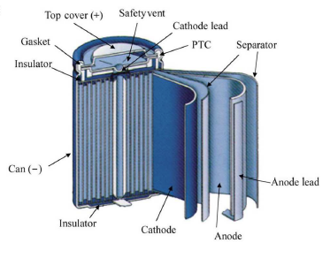
Battery Design
Cells produce an electric current by converting chemical energy into electrical energy
Two electrodes
  Negative (anode) - typically made of carbon (graphite)
  Positive (cathode) - generally consists of layers of lithium and metal oxide
Permeable barrier between the electrodes prevents internal short-circuiting
Electrolyte transfers charged ions between the electrodes. It consists of a lithium salt dissolved in an organic solvent, mainly carbonates.
Energy is related to the chemistry and construction of the LIB cell
Case 16: Lithium Ion Battery Fires in Electric Vehicles
4
Notes:
4

Slide 5
LIB Fires
Overview
Volatile organic electrolyte solution (hazardous)
Short circuit or high operating temp. can lead to exothermic reactions
Worst case scenario - battery catches fire or explodes (low frequency)
Different fire in terms of initiation, spread, duration, toxicity & suppression
Increase in fire risk is proportional to the increase in the mass and capacity of the battery (the fuel)
Last two decades
Variety of fires (small consumer electronics to large power systems)
Initial concerns with portable devices (cell phones and laptops)
Sony (2006) recalled 9.6 million notebooks with LIBs ($400 million)
Samsung (2016) recalled 2.5 million Note 7 smartphones ($17bn)
Boeing 787 Dreamliner grounding in 2013 (1.1 million USD/day loss)
Variety of electric vehicle fires including Chevy Volt and Tesla Model S
Case 16: Lithium Ion Battery Fires in Electric Vehicles
5
Notes:
5

Slide 6
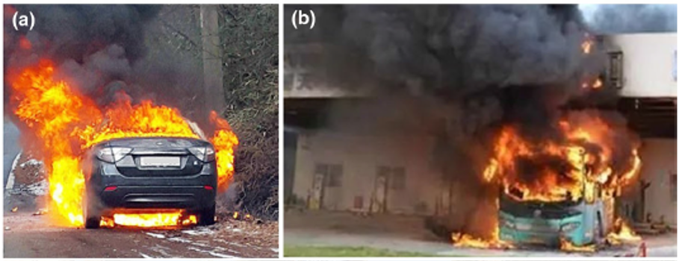
Electric Vehicle LIB related Fires
a) A Renault-Samsung EV caught fire while driving (January 2016, Korea)
b) A pure battery electric bus caught fire in a charging station (April 2015, Shenzhen, China)
Case 16: Lithium Ion Battery Fires in Electric Vehicles
6
Notes:
6
6

Slide 7
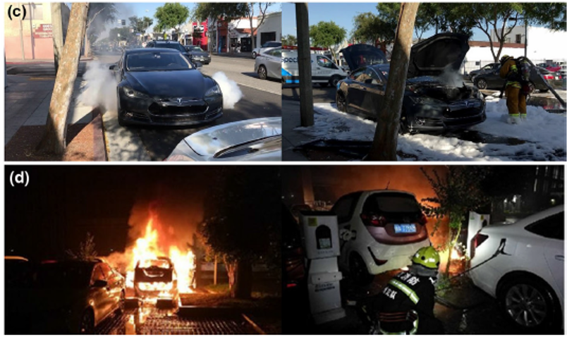
Electric Vehicle LIB related Fires
c) A Tesla Model S released smokes while being driven (June 2018, California)
d) EV fire in a parking lot (May 2018, Hangzhou, China)
Case 16: Lithium Ion Battery Fires in Electric Vehicles
7
Notes:
7
7

Slide 8
Thermal Runaway
EV battery packs are usually composed of thousands of single cells
A thermal runaway (TR) can initiate in a single cell and propagates to other cells in the pack
LIB temp. reaches a critical value such that the reaction rate of an exothermic reaction increases the temp. & accelerates the reaction rate
A fast process that occurs at a time scale <2 s, leading in most cases to battery rupture in less <0.01 s
Triggers for LIB TR
  External abuse (mechanical, thermal, electrical)
  Internal failure (defects, self-heating)
  Critical for LIB to balance heat generation with heat dissipation
Case 16: Lithium Ion Battery Fires in Electric Vehicles
8
Notes:
8

Slide 9
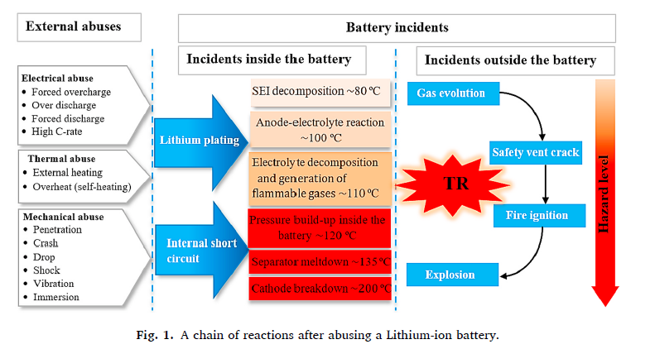
Chain of Events after abusing a LIB
Case 16: Lithium Ion Battery Fires in Electric Vehicles
9
Notes:
9

Slide 10
Bow Tie Risk Tool Overview
  Methodology has been used for over 20 years
  Builds on the Swiss cheese model
  Shows how a hazard can be released, escalate & controlled
  Helps communicate how to control major accident hazards
  Barriers required to either manage hazard or prevent/mitigate consequences
  Effective communication tool for leadership in ESRM
  Bow tie components:
    Hazard: what source of energy has the potential to cause harm
    Top Event: what happens when the hazard is released
    Threats: what causes the hazard to be released
    Consequences: PEAP impacts
    Threat controls: prevent the hazard from being released
    Recovery measures: limit the severity of the event and minimize impacts
Case 16: Lithium Ion Battery Fires in Electric Vehicles
10
Notes:
10

Slide 11
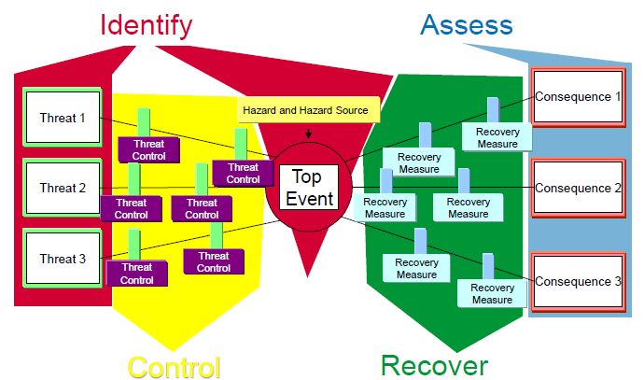
Simplified Bow Tie Diagram
Case 16: Lithium Ion Battery Fires in Electric Vehicles
11
Notes:
11

Slide 12
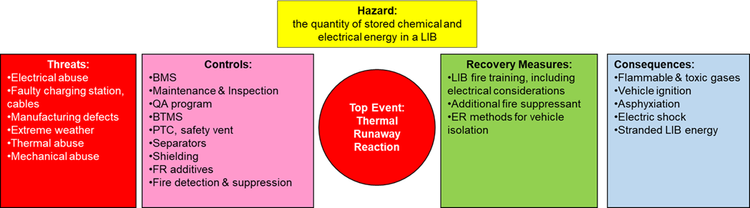
Simplified Bow Tie Diagram for EV LIB fire
Case 16: Lithium Ion Battery Fires in Electric Vehicles
12
Notes:
12

Slide 13
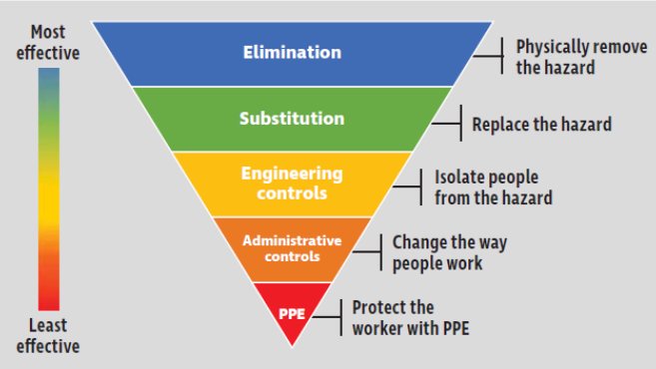
Prevention Through Design
  Preventing battery failure which sometimes lead to TR & fires has remained a challenge for LIBs
  Recall PTD focus is to “engineer out the hazards” through our designs
  PTD focus area is battery chemistry and design to prevent TR fires
  PTD with inherently safer materials:
    Cathode chemistry
    Modified separators
    Modified electrolytes
    Solid state batteries
Case 16: Lithium Ion Battery Fires in Electric Vehicles
13
Notes:
13

Slide 14
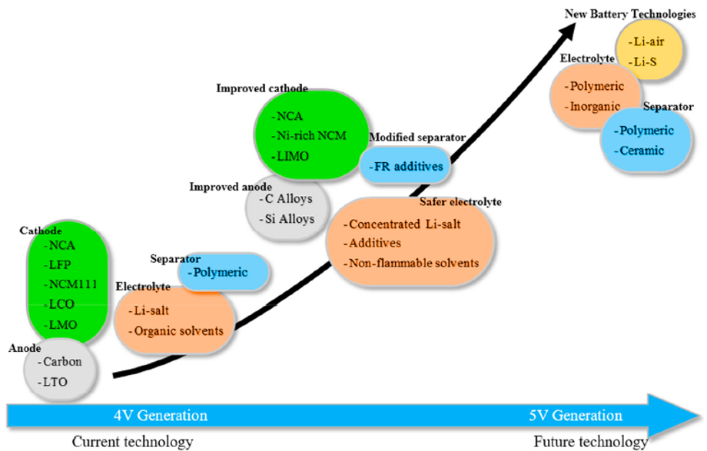
Potential PTD Opportunities for LIBs
Case 16: Lithium Ion Battery Fires in Electric Vehicles
14
Notes:
14

Slide 15
Summary & Key Lessons
LIB technology is superior but the current designs have the risk of a low frequency, high consequence risk event (fires to thermal runaway)
A variety of LIB-related fires have occurred over the last two decades
A bow tie diagram provides a simple visual depiction of a complex situation (especially when dealing with non-specialists)
Prevention through design opportunities are in the area of inherently safer design that reduce the frequency of LIB-related fires
Case 16: Lithium Ion Battery Fires in Electric Vehicles
15
Notes:
15

Slide 16
Back up Slides
Case 16: Lithium Ion Battery Fires in Electric Vehicles
16
Notes:
16

Slide 17
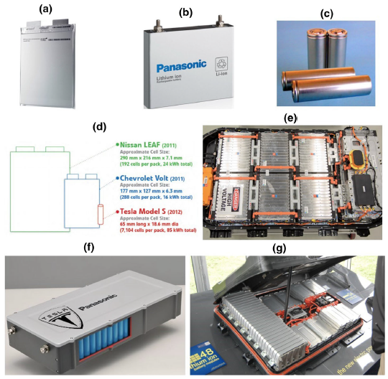
Typical EV Battery Cells
Pouch cell
Prismatic cell
Cylindrical cell
Approximate battery size in popular EVs
Fully assembled LG 60kWh battery pack (288 prismatic cells)
Tesla battery module
Nissan Leaf battery pack
Case 16: Lithium Ion Battery Fires in Electric Vehicles
17
Notes:
17

Slide 18
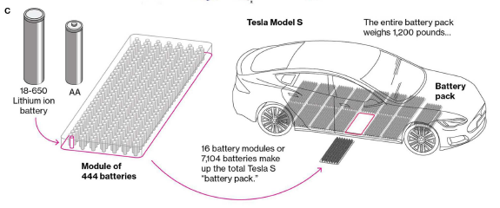
Multi-cell pack for Tesla Model S
Case 16: Lithium Ion Battery Fires in Electric Vehicles
18
Notes:
18

Slide 19
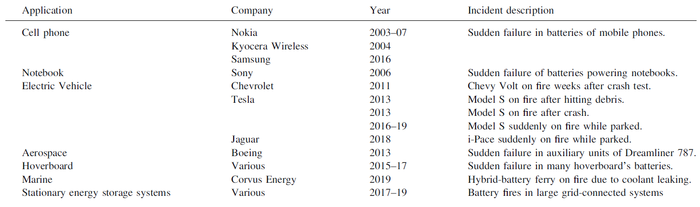
LIB Fires with Significant Media coverage
Case 16: Lithium Ion Battery Fires in Electric Vehicles
19
Notes:
19

Slide 20
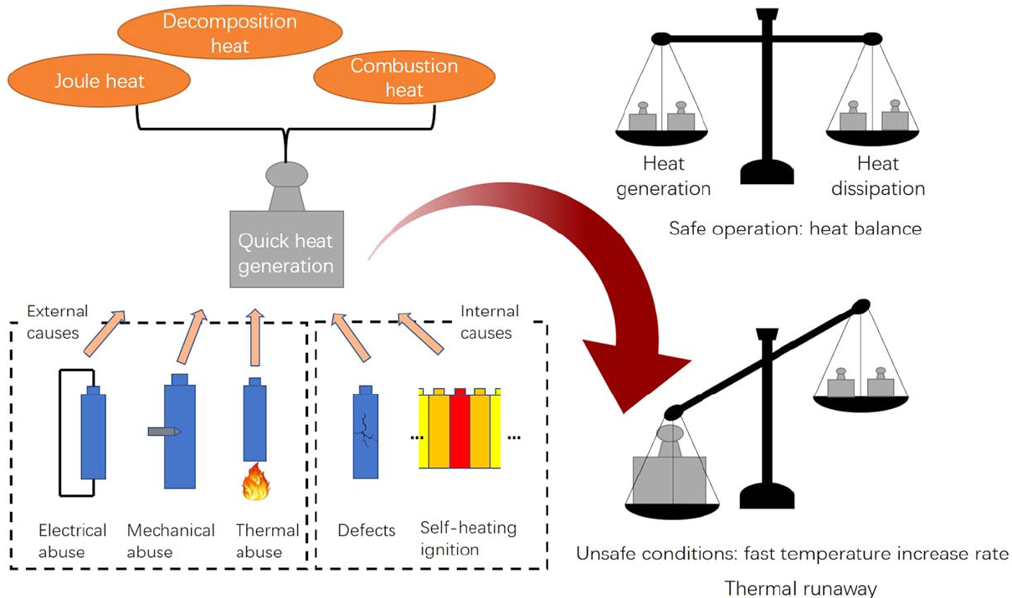
LIB TR due to imbalance between heat generation & dissipation
Case 16: Lithium Ion Battery Fires in Electric Vehicles
20
Notes:
20

